Slide 1
Adaptive Boosting

Slide 2
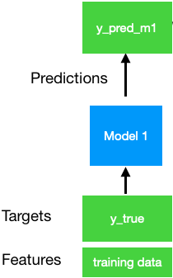
AdaBoost
Series of weak learners become a strong learner
Series of models, focuses on learning the mistakes it’s predecessor makes (by focusing more on the samples they got wrong)

Slide 3
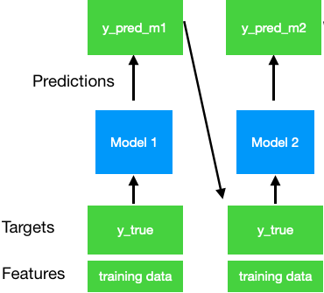
AdaBoost
Series of weak learners become a strong learner
Series of models, focuses on learning the mistakes it’s predecessor makes (by focusing more on the samples they got wrong)

Slide 4
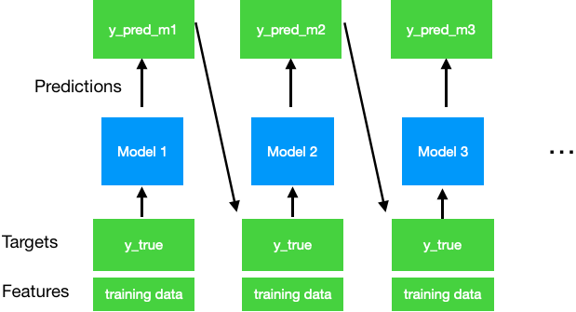
AdaBoost
Series of weak learners become a strong learner
Series of models, focuses on learning the mistakes it’s predecessor makes (by focusing more on the samples they got wrong)

Slide 5
AdaBoost
Series of weak learners become a strong learner
Series of models, focuses on learning the mistakes it’s predecessor makes (by focusing more on the samples they got wrong)
Sample weight updates across estimators

Slide 6
AdaBoost
Sample weight updates
In scikit-learn weights are scaled using exponentials that depend on the size of the error as well as estimator weight

Slide 7
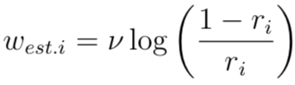
AdaBoost
Estimator weights
r - estimator error
- learning rate
estimator weight
Final prediction is weighted vote or average (median in sklearn)

Slide 8
Regularization
Regularization
Number of estimators, early stopping
Base Estimator
Performance
SAMME Discrete vs Real
Real uses predict_proba, which can lead to better test set performance

